Slide 1
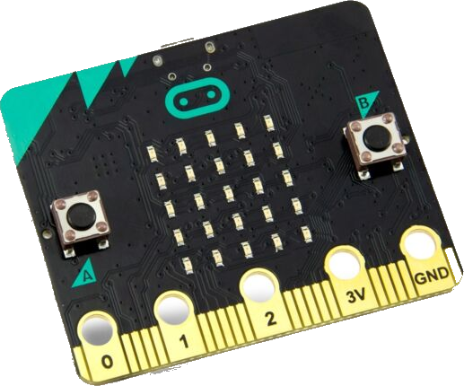

Handleiding Leeuw

Slide 2
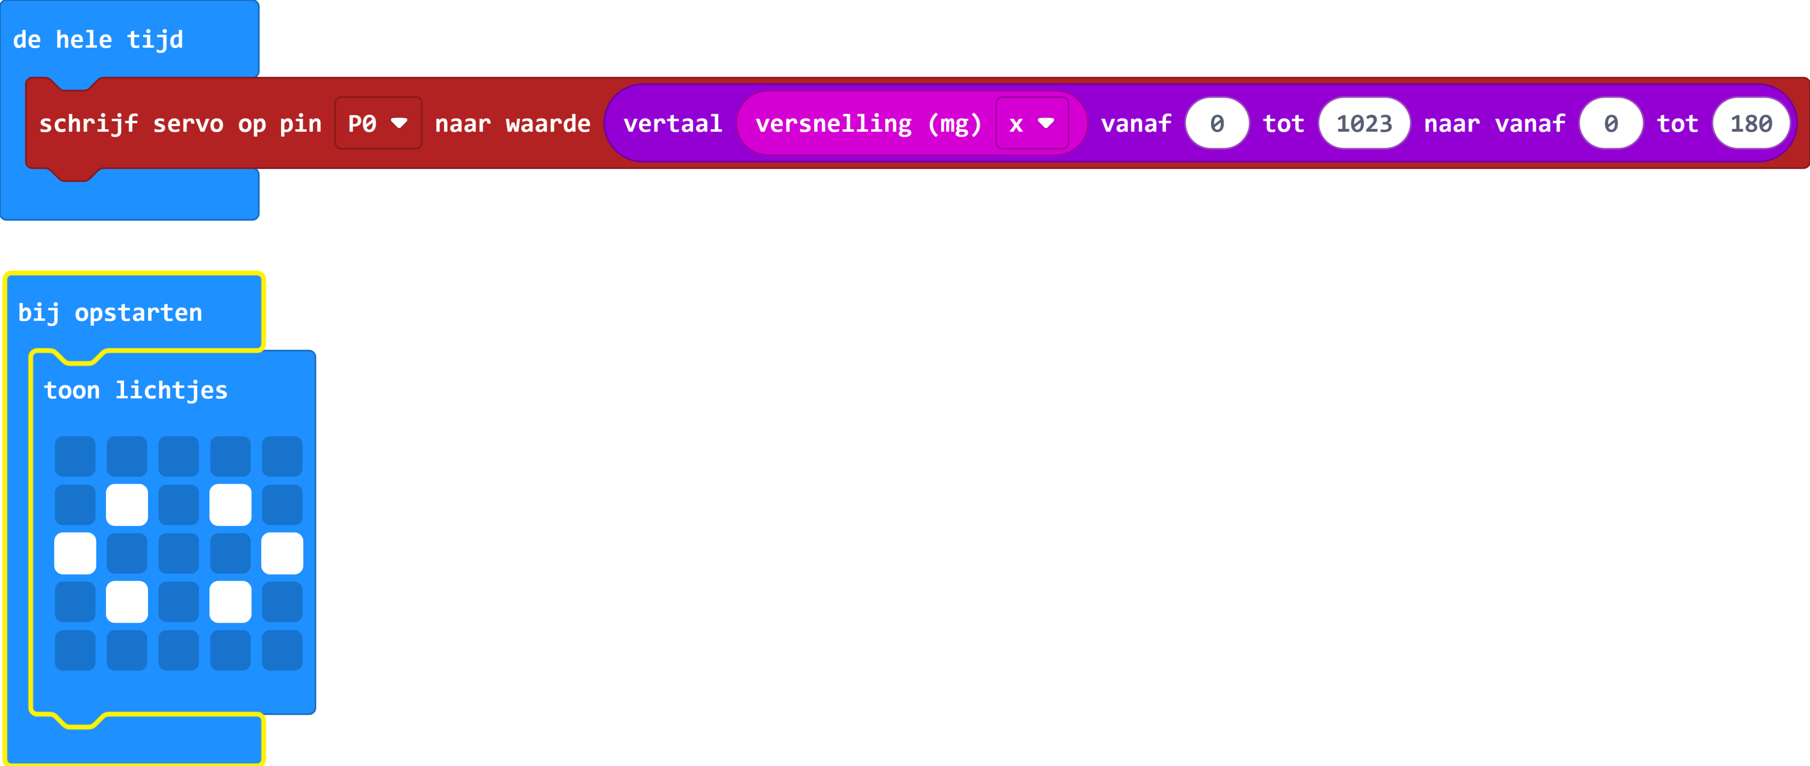

https://makecode.microbit.org/S97282-36874-56911-14248

